Slide 1
SIXTH SENSE DEVICE
Presented By:
Ankita A. Gothi (71700218H)
Riya S. Huddar (71700231E)
Project Guide : Prof. Harshali Zodpe

Slide 2
Work completed during SEM-1
Hand Gesture Recognition based Image capture
application of Sixth Sense Device was developed and tested during SEM-1.

Slide 3
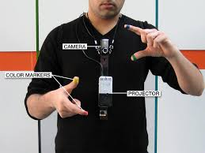
Abstract
Sixth Sense is a wearable gesture interface that augments the physical world with digital world around us. The information can be displayed on any surface like walls etc. thus making entire world your computer.
The Sixth Sense prototype is used to implement several applications that have shown the usefulness, viability and flexibility of the system.

Slide 4
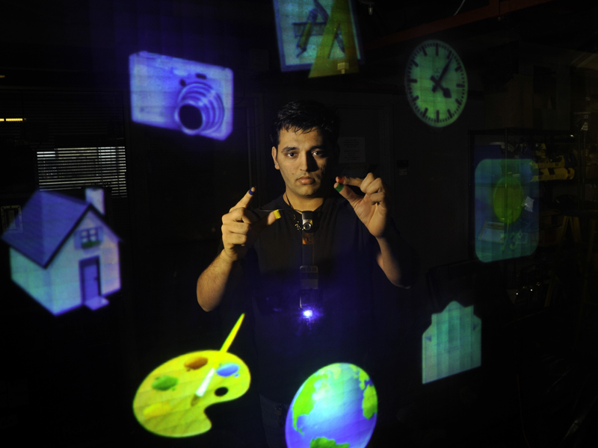
BASIC AIM
The basic aim of this project is to create a SIXTH SENSE DEVICE which works on the principle of Gesture Recognition and Image Processing and to be able to incorporate digital world in the physical world.

Slide 5
Motivation
The sixth sense technology was developed by Pranav Mistry. At present the commercial product isn’t launched but the prototype is prepared. Sixth Sense technology acts as bridge between physical and digital world. It enables us to interact with our surroundings with the help of gestures.
Dynamic Gesture recognition requires accurate and fast recognition. Gesture recognition using flex sensors provide low accuracy whereas Gesture recognition using DWT requires more time. Image processing technique proposed in this system proves to be most efficient technique for Gesture Recognition and Drawing Application.

Slide 6
Literature Survey
Sixth Sense technology is implemented in 'Sixth Sense/WUW (Wear Your World) using gesture recognition, augmented reality, computer vision and radio frequency identification [1].
Gesture recognition can be implemented by three techniques viz. static and real-time using image processing techniques and flex sensor techniques. The recognition rate of gesture recognition using flex sensors is found to be 86% whereas the recognition rate of other two gesture recognition techniques is Highly Accurate (provided with good lighting condition and clear white background) [2].
Another approach for hand gesture recognition involves Hidden Markov Model [3]. The Hidden Markov Model (HMM) performs fingertip detection and tracking of dynamic videos, but it is not enough in HCI applications..
Another approach is proposed for hand gesture recognition that is accomplished by dominant points based hand ﬁnger counting under skin color extraction. [4].
Electromyography technique can also be used for Gesture Recognition.[5]
Daubechies Wavelet Transform is used for Gesture recognition in [6].
A method for counting open fingers and virtual drawing in real time using color detection and shape detection algorithms is designed in [7].

Slide 7
Comparative Study of Hand Gesture Recognition using various methods:
 | Gesture Recognition with Electromyo-graphy (EMG) [5] | Flex Sensor based Gesture Recognition [2] | DWT (Daubechies Wavelet Transform) [6] | Image Processing based Gesture Recognition [2]
Accuracy(%) | 86% | 84% | 100% | 100%
Time required to recognize a gesture. | Less | Moderate | More | Less

Slide 8
Proposed System
Some of the traditional systems of gesture recognition use flex sensors that measure the amount of deflection or bending. The system which we propose uses image processing techniques to detect gestures. The flex sensors technique is costly and is more susceptible to errors. So image processing technique is more advantageous.
For Drawing Application Blue Coloured cap is used to draw virtually on the screen and drawn diagram is visible to user in Paint Window. Hence, this system is easy to interact and use by any new user.

Slide 9
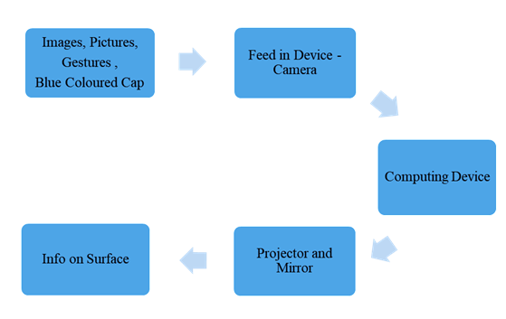
SIXTH SENSE DEVICE BLOCK DIAGRAM

Slide 10
Steps for Gesture Recognition
Segmentation: Image segmentation is the process of partitioning a digital image into multiple segments (sets of pixels, also known as image objects).
Thresholding: Image thresholding is a simple, yet effective, way of partitioning an image into a foreground and background.
Contours: Contours can be explained simply as a curve joining all the continuous points (along the boundary), having same color or intensity.
Convex Hull: Given a set of points in the plane. the convex hull of the set is the smallest convex polygon that contains all the points of it.

Slide 11
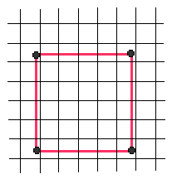
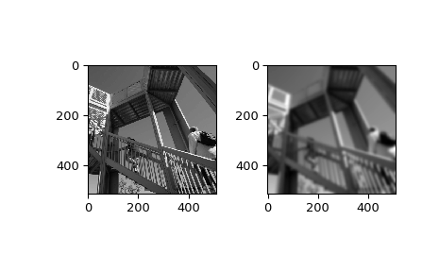
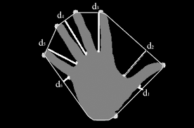
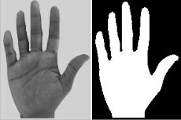
Region of Interest
Gaussian Filtering
Contours and Convex Hull
Segmentation and Thresholding

Slide 12
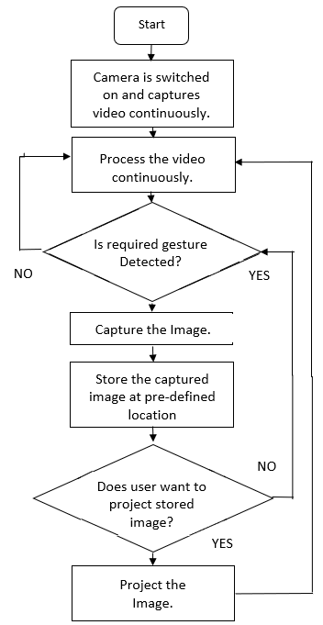
Working of Gesture Recognition based Image Capture

Slide 13
Steps for Drawing Application
Color Recognition: Color recognition is done through computer vision. Color recognition involves detection of appropriate color.
Contour: A contour of all the continuous points is plotted .
Center of the contour is obtained.
Tracing: The center is traced and user is able to draw on the virtual paint application.

Slide 14
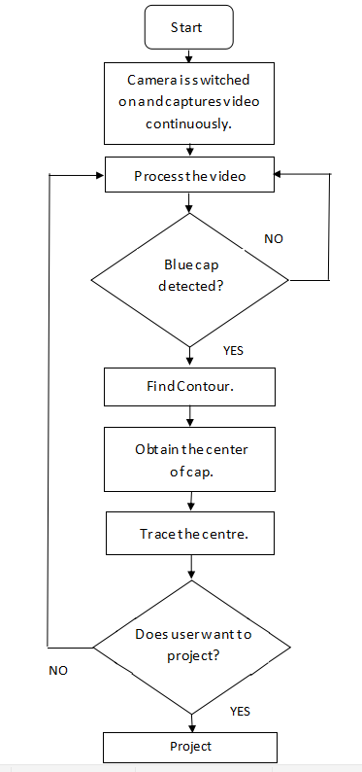
Working of Drawing Application

Slide 15
Results
1.Gesture Recognition based Image Capture
The camera continuously captures real time video stream and once the appropriate gesture i.e. gesture of two having one convexity defect and angle between two fingers less than 70 degree is detected an image is captured.
The accuracy of recognition of the gesture is detected using the Table . Table shows the actual and the corresponding interpreted gestures. For each gesture 10 test cases are considered.

Slide 16
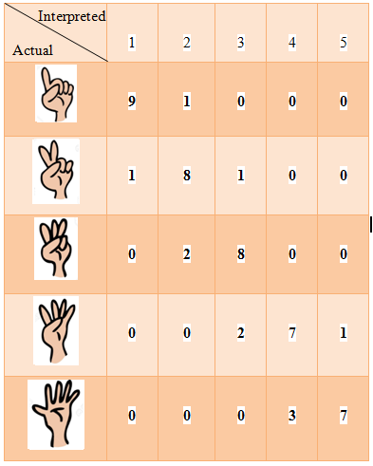
Hand Gesture Recognition Observation Table

Slide 17

Confusion Matrix
The accuracy of the system can be evaluated as-
Accuracy = (TP+TN)/ (TP+TN+FP+FN)
Substituting the values,
Accuracy= (45/50)*100=90%
Thus, accuracy of the system is calculated to be 90%. For this system plain background is desired and the
required gesture should be adjusted in the required rectangular field.
The system performs reliably for hand gesture recognition if these two conditions are ensured.
When required gesture is detected camera captures the image.

Slide 18
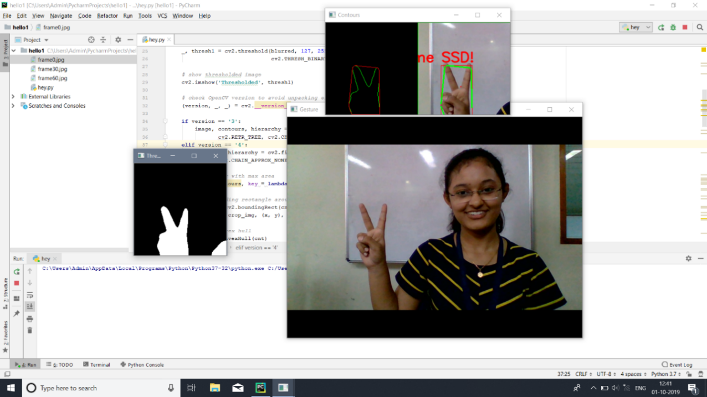
Image Capture Based on Hand Gesture Recognition Result

Slide 19
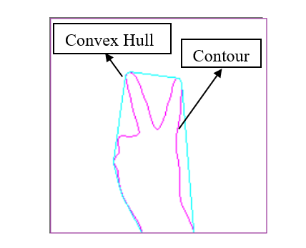

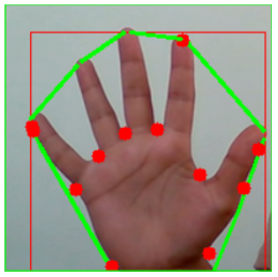
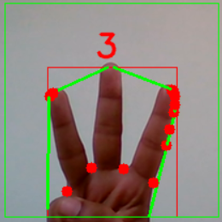
Segmentation
Contour and Convex Hull
Convexity Defects
Finger Count

Slide 20
2.Drawing Application:
The camera continuously captures real time video stream and once the blue coloured cap is detected, contour of the cap is found and its centre is traced as shown in Tracking Window. If the centre is passed through any of the colour buttons that is BLUE, GREEN, RED or YELLOW placed at the top of window, path is drawn with the respective colour.
If the centre of the cap is passed through CLEAR ALL button placed at top left of the window ,then the screen is cleared and in the similar way, if the centre of the cap is passed through SAVE button placed at bottom then the Paint window with whatever drawn is saved at particular location.

Slide 21
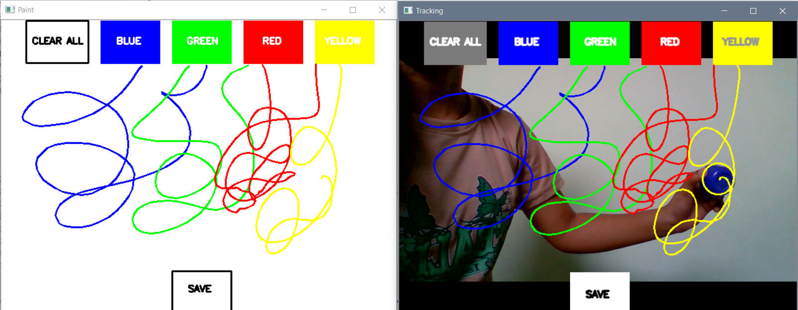
Drawing Application Result

Slide 22
3.GUI
A GUI is designed using Tkinter library which provides binding to the Tk GUI toolkit. It is the standard python interface to the Tk GUI toolkit.
On the interface, buttons are provided to the user to access particular application.
The Gesture Recognition based Image capture application stores the image in desired location on recognition of a particular gesture.
The drawing application also stores the paint window in desired location when the centre of the blue cap passes through save button. A button on the interface allows users to view all these saved images and paint windows. For viewing all these images Image Viewer is developed. This allows users to select the desired image and view it on the Canvas of the Photo Viewer.

Slide 23
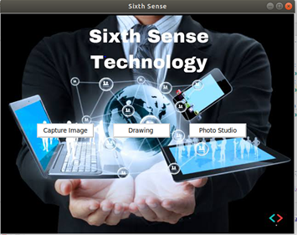
Graphical User Interface
Graphical User Interface (GUI) provided to user for interacting with the application. The user is provided different tabs to start a particular application or view the saved images or drawings.

Slide 24
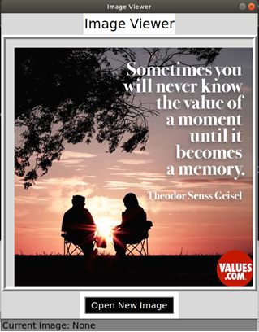
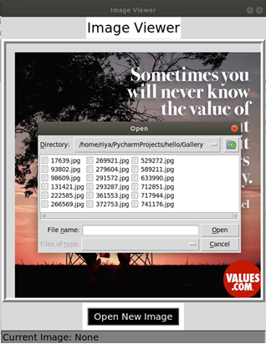
Image Viewer Open New Image Tab
Above images are of the Image Viewer which can be accessed by clicking on the Photo Studio tab on GUI. Image viewer is used to view the saved images and drawings from the applications.

Slide 25
System Complexities
The system is affected by Background noise. Therefore, Gaussian filter needs to be applied for smoothening. Also background should be noise free.
The Hand gestures by user are recognized based on convexity defects, therefore gestures need to be proper.
For Drawing Application, the blue colored thing which we are using for drawing purpose should be with maximum contour area in the frame.

Slide 26
Conclusion
This project implements hand gesture recognition to capture a particular image and store at desired location for further processing. The prototype implements this application, allowing us to interact with this information via natural hand gestures. This system provides accuracy of 90%.
A Drawing application is also developed which is based on color tracking, computer vision and image processing. The camera monitors the background and the path of blue cap is traced. In this way, system allows us to draw remotely via colored tracking.
Many more applications can be developed based on the concept of Sixth Sense like calling application, projected clock. Functionalities like zoom in and zoom out can also be developed as a future scope.

Slide 27
References
1]Sixth Sense Technology S.Pradeep Kumar, Asst.Prof, Rajalakshmi Institute of Technology, Chennai O.Pandithurai, Phd (scholar) Anna university of Technology Comibatore, India.
2]Comparative Study for Vision Based and Data Based Hand Gesture Recognition Technique OinamRobita Chanu1, Anushree Pillai2, Spandan Sinha3, Piyanka Das4 Department of Biomedical Engineering SRM University, Kattankulathur, Chennai, India
3] A Hidden Markov Model based Dynamic Hand Gesture Recognition System using OpenCV Rajat Shrivastava Dept. of Electronics and Communication Engineering
4] Dominant Points based Hand Finger Counting for Recognition under Skin Color Extraction in Hand Gesture Control System ZhenYu Meng Jeng-Shyang Pan, Kuo-Kun Tseng and WeiMin Zheng Intelligence Control Research Center, Guangzhou Institute of Advanced Technology Chinese Academy of Sciences, Guangzhou, China Computer Science Department, Shenzhen Graduate School Harbin Institute of Technology, Shenzhen, China
5] Real-Time Hand Gesture Recognition With EMG Using Machine Learning
Andr´es G. Jaramillo and Marco E. Benalc´azar Departamento de Inform´atica y Ciencias de la Computaci´on Escuela Polit´ecnica Nacional, EPN Quito, Ecuador
6]Hand Gesture Recognition by Daubechies Wavelet Transformation Dr. Tanuja K. Sarode*, Priyanka Agrawal*, Gaurav Deshpande*, Anjali Jogeshwar*
7]Real Time Finger Counting and Virtual Drawing Using Color Detection and Shape Recognition Dr. GhousBukshNarejo Department of Electronic Engineering NED University of Engineering and Technology Karachi, Pakistan Shahyan Pervez Bharucha Department of Electronic Engineering NED University of Engineering and Technology Karachi, Pakistan

